Slide 1
Analytical Paper Presentation
Interpretation of Gun Speeches

Slide 2
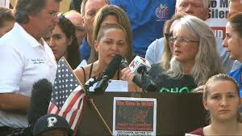
Introduction
The analytical paper is about the interpretation of 2 gun speeches
The speeches were made by Emma Gonzalez and Kaitlin Bennett.
The speeches followed a criminal shooting in one of the schools in Florida.
Emma is against the increased circulation of guns in society.
Kaitlin is advocating for the right to own guns (Gonzalez & Bennett, 2018).
Notes:
The analytical paper is an interpretation of gun speeches delivered by Emma Gonzalez and Kaitlin Bennett in Florida following a criminal shooting that left 17 dead (Gonzalez & Bennett). The rate of mass shootings has increased in the United States, and this is highly attributed to the weak regulation of gun ownership. Emma Gonzalez is condemning the act that occurred in her school, and she is also accusing the government of not initiating and implementing adequate measures to protect the welfare of the civilians. On the other hand, Kaitlin Bennett is championing the right to own guns for maximum protection.

Slide 3
Target Audience
Emma is addressing the entire public, gun advocates, and legislatures.
She is also addressing President Trump and NRA.
Kaitlin is addressing all anti-gun individuals.
She is calling upon the youth to fight for their right to own guns.
Kaitlin is also addressing the pro-second amendment individuals (Staff, 2018).
Notes:
Emma Gonzalez is addressing her speech to the entire public and gun advocates and legislators. Gonzales is heard calling out President Trump and NRA for failing to set up harsher laws for gun buyers to prevent such horrendous acts as the criminal killing in Marjory Stoneman Douglas High School from occurring. Kaitlin is addressing all anti-gun individuals (Staff, 2018). She is addressing this speech to those who believe that gun laws should be made harsher and wants to inform those people that if gun laws are made harsher, it isn't going to stop someone from finding a gun. She is also directing her speech to the youth and urges them to increase their activism to have them allowed to own guns.

Slide 4
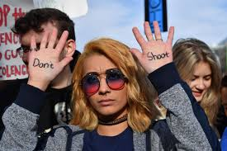
Purpose of the Speeches
The purpose of her speech is to enlighten the public that they at risk due to poor gun regulation.
Kaitlin's speech is made to urge the youth to fight for their right to own guns.
She is rallying the youth to increase their activism in order to be allowed to own guns.
Kaitlin's words are in line with those stated by A. E Samaan (Goodreads, 2020).
Notes:
The purpose of her speech is to enlighten the public that they at risk due to poor gun regulation, and therefore they must all take a stand and have their voices heard so that these laws can change and that people with criminal records and those that have a history of mental illness can be prevented from buying and owning guns. The purpose of Kaitlin's speech is to inform anti-gun advocates about the pro-gun advocates' point of view. She wants these individuals to know that the right to carry a gun, which is a citizen's second amendment right, should not be taken away because of the individuals that have committed these acts. Kaitlin's words concur with those stated by A. E Samaan when he noted that, "The right to self-defense is inalienable from the right to life. Weaken one, and the other is devalued" (Goodreads, 2020). These words mean that the right to life and self-defense go hand-in-hand, and if one is violated, the other is also violated.

Slide 5
Content of the Speeches
Emma's speech involves a call to Prescient Trump and National Rifle Organization (NRA).
She notes that there is poor regulation of guns in the US.
As a result, gun possession has increased, making criminal activities to skyrocket.
Kaitlin is calling for a revolution of gun control in the country.
Primarily, Kaitlin is rallying the youth to stand for their right to own guns (Palomino et al., 2019).
Notes:
The content of Emma's speech is to call upon President Trump and the NRA by advocating for her and the families of those that have lost their loved ones to these horrendous shootings (Palomino et al., 2019). The sediments show that the government is not doing much to counter criminal activities, and therefore it was the time for the civilians to act and advocate for the change they wanted in the society. According to Emma, gun ownership is not regulated, and anyone can own this sensitive product. Emma's words concur with those stated by Stewart Stafford when he stated that "America is drowning in guns. Even if they were all banned from midnight tonight, it would probably take a century or two to get them all out of circulation and maybe not even then" (Goodreads, 2020). This means that society is flooded with guns. Kaitlin is advocating for the revolution of gun control and regulations. She is calling upon the youth to stand up and champion the right of owning guns.

Slide 6
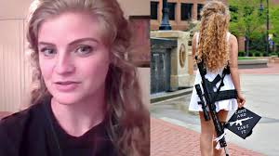
The Speaker's Moods
Emma displays an angry mood.
Emma is portraying her anger to the President, legislators, and NRA.
Kaitlin displays a mixture of disappointment and liberation.
She feels disappointed because her second amendment right has been violated.
Kaitlin notes that civilians should be able to hold their guns in public (Bamforth, 2018).
Notes:
The mood that Emma displays in her speech is anger. She is angry with the President, legislators, and NRA. Emma accuses the President of liaising with NRA to siphon corruption money at the expense of the security of the civilians (Bamforth, 2018). She is also angry because neither the President nor NRA has come out in public to condemn the increasing shootings in the country. She is angry that even one tragedy like this has to happen, and children need to lose their lives because money is more important to them than the lives of children. The mood that Kaitlin displays in her speech is anger but more so disappointment and possibly liberating. She feels disappointed because her second amendment right has been violated. Kaitlin portrays liberation when she adds that all civilians should be able to stand with an automatic gun. Liberian is also depicted by Kaitlin's words that she is rallying the youth to progress with their activism.

Slide 7
Style of Speech
Both speakers use an informative style of speech.
She is also informing the public why they should stand up for their rights.
Emma is informing the public about the tragedies that have occurred to the poor regulation of guns.
Kaitlin informs the public of some of her experiences with owning guns.
She informs the public that the reason for being allowed to own guns is for their protection.
Notes:
Both Emma and Kaitlin use the informative style of speech in their public addresses. Emma is informing the public of the tragedies that have occurred because of mass shootings, and she is stating the reasons as to why people need to stand up and have their voices heard to the President, legislators, and any individuals or organizations that believe that harsher laws should not be made to prevent such acts from occurring. Overly, Emma is informing the public that the increased criminal activities associated with guns are as a result of poor regulation of guns. Emma's words are well supported by Mark Bello, the author of the book Betrayal High, when he stated that "If a buyer is having trouble getting a gun in Michigan, he or she just travels to Ohio or Indiana or Illinois. You know what I mean" (Goodreads, 2020)? Kaitlin captures her audience's attention but stating that she would much rather have an audience full of people that carry a fully loaded automatic weapon than not. She informs the public that the reason for being allowed to own guns is for their protection.

Slide 8
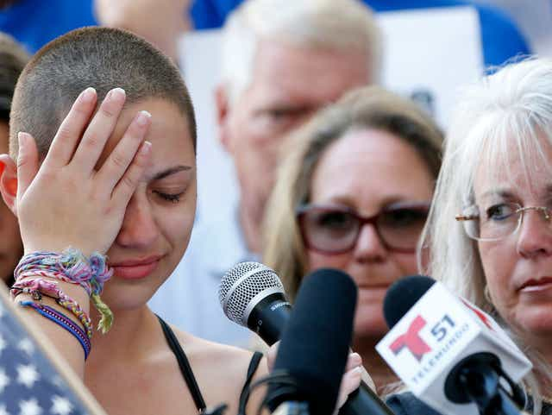
Structure of the Speeches
Both Emma and Kaitlin present their speeches chronologically.
Emma begins by paying tribute to the deceased individuals.
She then informs the public that the government has failed its citizens.
Kaitlin begins by narrating her experience with the Parklands kids.
She then explains how gun-free zones have been leading to gun violence.
She ends with her activism quest (Bamforth, 2018).
Notes:
Both Emma and Kaitlin present their speeches chronologically. Notably, Emma begins her speech by requesting the audience to observe a moment of silence for the deceased individuals. She then informs the public that the government has failed its citizens by failing to initiate and implement strong rules that guide the ownership of guns. Emma notes that the government's effort to implement the Second Amendment has ironically increased the illegal ownership of guns and a subsequent increase in criminal activities. Kaitlin begins her speech by her journey to the Parklands kids and then explains how gun-free zones have been ironically leading to gun violence (Bamforth, 2018). Kaitlin ends her speech by calling upon the youth to hasten their activism to be allowed to own guns.

Slide 9
Conclusion
The analytical paper is an interpretation of gun speeches.
The speakers are Emma Gonzalez and Kaitlin Bennett.
The speeches followed the mass shooting in Florida.
This criminal activity claimed the lives of 17 individuals.
Notes:
The analytical paper is an interpretation of gun speeches delivered by Emma Gonzalez and Kaitlin Bennett. The speakers spoke after a perpetrator illegally entered one of the schools and killed 17 individuals, and left several nursing injuries in hospitals.

Slide 10
References
Bamforth, E. (2018, August 13). Kent State University graduate whose photos with AR-10 went viral to host campus gun rally. Retrieved from Cleveland website: https://www.cleveland.com/metro/2018/08/kent_state_university_graduate_2.html
Gonzalez, E., & Bennett, K. (2018, February). To Lawmakers and Gun Advocates.
Goodreads. (2020). School Shooting Quotes. Retrieved from https://www.goodreads.com/quotes/tag/school-shooting
Palomino, S., Aoki, E., Khrebtan-Hörhager, J., & Black, R. (2019). Retrieved from https://mountainscholar.org/bitstream/handle/10217/197294/Palomino_colostate_0053N_15516.pdf?sequence=1
Staff, C. (2018). Florida student Emma Gonzalez to lawmakers and gun advocates: "We call BS." Retrieved from CNN website: https://www.cnn.com/2018/02/17/us/florida-student-emma-gonzalez-speech/index.html

